Slide 1
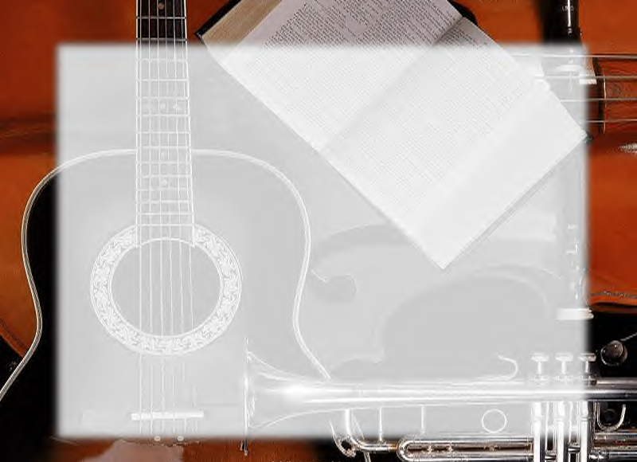
S.D.A Hymnal
4 ~ Verses
90.
Omukemi Ya’ngamba.…
~
The Tempter to My Soul…

Slide 2

KALERWE
S.D.A Hymnal
4 ~ Verses
90.
Omukemi Ya’ngamba.…
~
The Tempter to My Soul…

Slide 3

1 of 4 verses
Omukemi ya’ngamba nti
“Ggwe tolina omubeezi!”
Mukama Ggwe, Ngabo yange,
Gwe onkume, onnyimuse!

Slide 4
2 of 4 verses
(O)bulokozi buva gy’oli,
Mu kifo ky(o) ekitukuvu.
Nkowoola n’eddoboozi. Bw’oyogera nalokoka.

Slide 5
3 of 4 verses
Golokoka ondokole!
Kubanga Gwe wawangula
Abalabe bange bonna
N’omenya amaanyi gaabwe.

Slide 6
4 of 4 verses
Nagalamir(a) okwebaka
Ne nzukuka,
Ggwe ng(a) onkuuma
Sitya bukumi bwa bantu
Abetolol(a) okunnumba

